Slide 1
FID’LIN: THE FIDDLE AND VIOLIN PRACTICE APP
Team 2
Jakob Beckleheimer, Dylan Brownell, Tanner Groll, Derek Pendleton, & Phil Snider
Notes:
Phil will do introduction
We are Team 2, our project is an app that assists the user in various ways with the fiddle or violin instrument.

Slide 2
DESCRIPTION
A functioning mobile app in which its purpose is to assist the user in various ways with the fiddle or violin. It allows the user to create a profile and keep up with progression on learning their instrument. It additionally helps the player tune their instrument by recording the pitch of the instrument and notifying the user to tune the instrument to a higher or lower pitch. This app also helps the user learn basic scales and keeps up with tempo using a metronome.
Notes:
Phil will handle slide.
Our app will allow for profiles to be made that keep track of progression with learning the instrument. It will also help the user tune their instrument, learn basic scales, and keep up with tempo.

Slide 3
REQUIREMENTS
User friendly menu
Personal profile keeps up with progress
Tuning assist
Assist with scales
Keeps up with tempo
Intonation assistance
Notes:
Phil can cover this slide, but may be Tanner should since he did Req. doc

Slide 4
TOOLBOX
Writing in C#
VS Community
Notes:
Derek will speak on this slide

Slide 5
TEAM 2’S COMMUNICATION MEDIUM
Trello
Github
Discord
Notes:
Derek will speak on this slide

Slide 6
CONTENT DISTRIBUTION PLAN
Github is the primary location where source control will occur
All active working code and documents will be stored here.
Every week a zip file of the full Github repo will be deposited in Blackboard
Notes:
Derek will speak on this slide

Slide 7
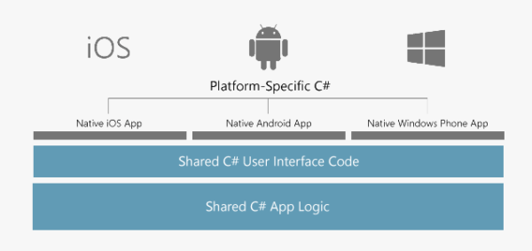
GENERAL DEV PLAN
Image Source: https://visualstudio.microsoft.com/xamarin/.
Notes:
Derek will speak on this slide:
The general plan will be outlined here. We plan to first build the shared backend code as well as the shared user interface. Once that is finished, we will build the platform specific C# code.

Slide 8
DOCUMENTS
System Implementation Doc – Phil
UML Diagrams – Jakob
Business Requirements Specifications
Test Plan
Updated Product Backlog

Slide 9
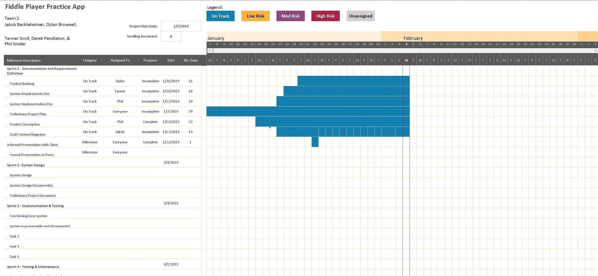
SYSTEM IMPLEMENTATION DOC
Notes:
Phil will talk here. Used a gantt chart template from Excel that is fairly easy to use and user friendly. Since we are still in the early stages of this project, it doesn’t have much. However, it will be updated regularly.

Slide 10
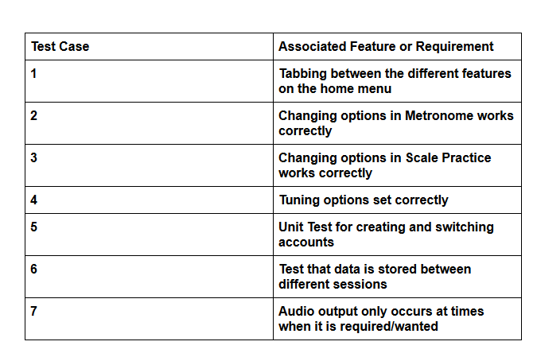
Test Plan
Early development stages so the test plan and test cases will likely change drastically over the next few weeks
Examples (right) of some test cases that will need to be developed in detail
Plan also includes: Testing strategy, Test Cycles, Test Management, Test Risks
Plan to use trello for dividing testing tasks among the group (easy to sort priority that way)

Slide 11
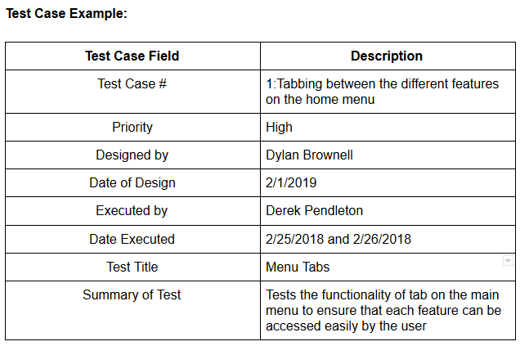
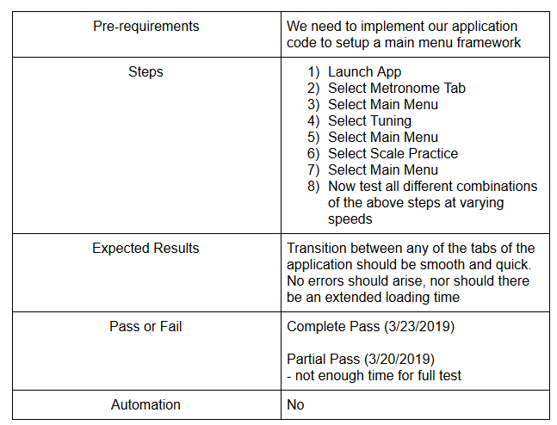
Example of what future test cases will look like

Slide 12
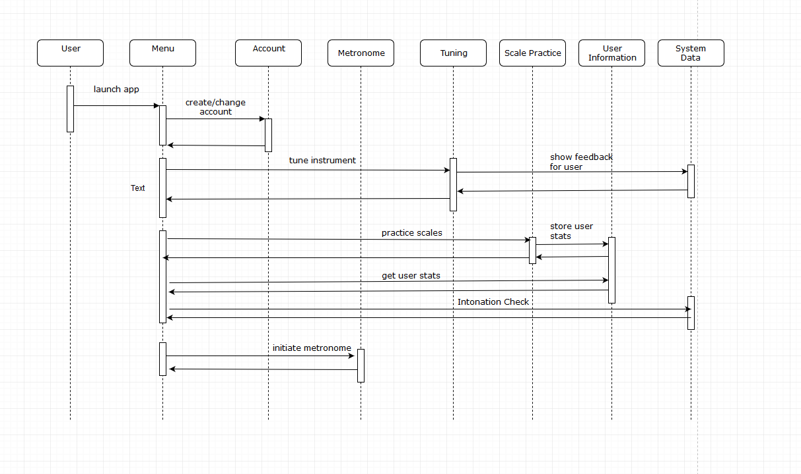
Sequence Diagram 1.0

Slide 13
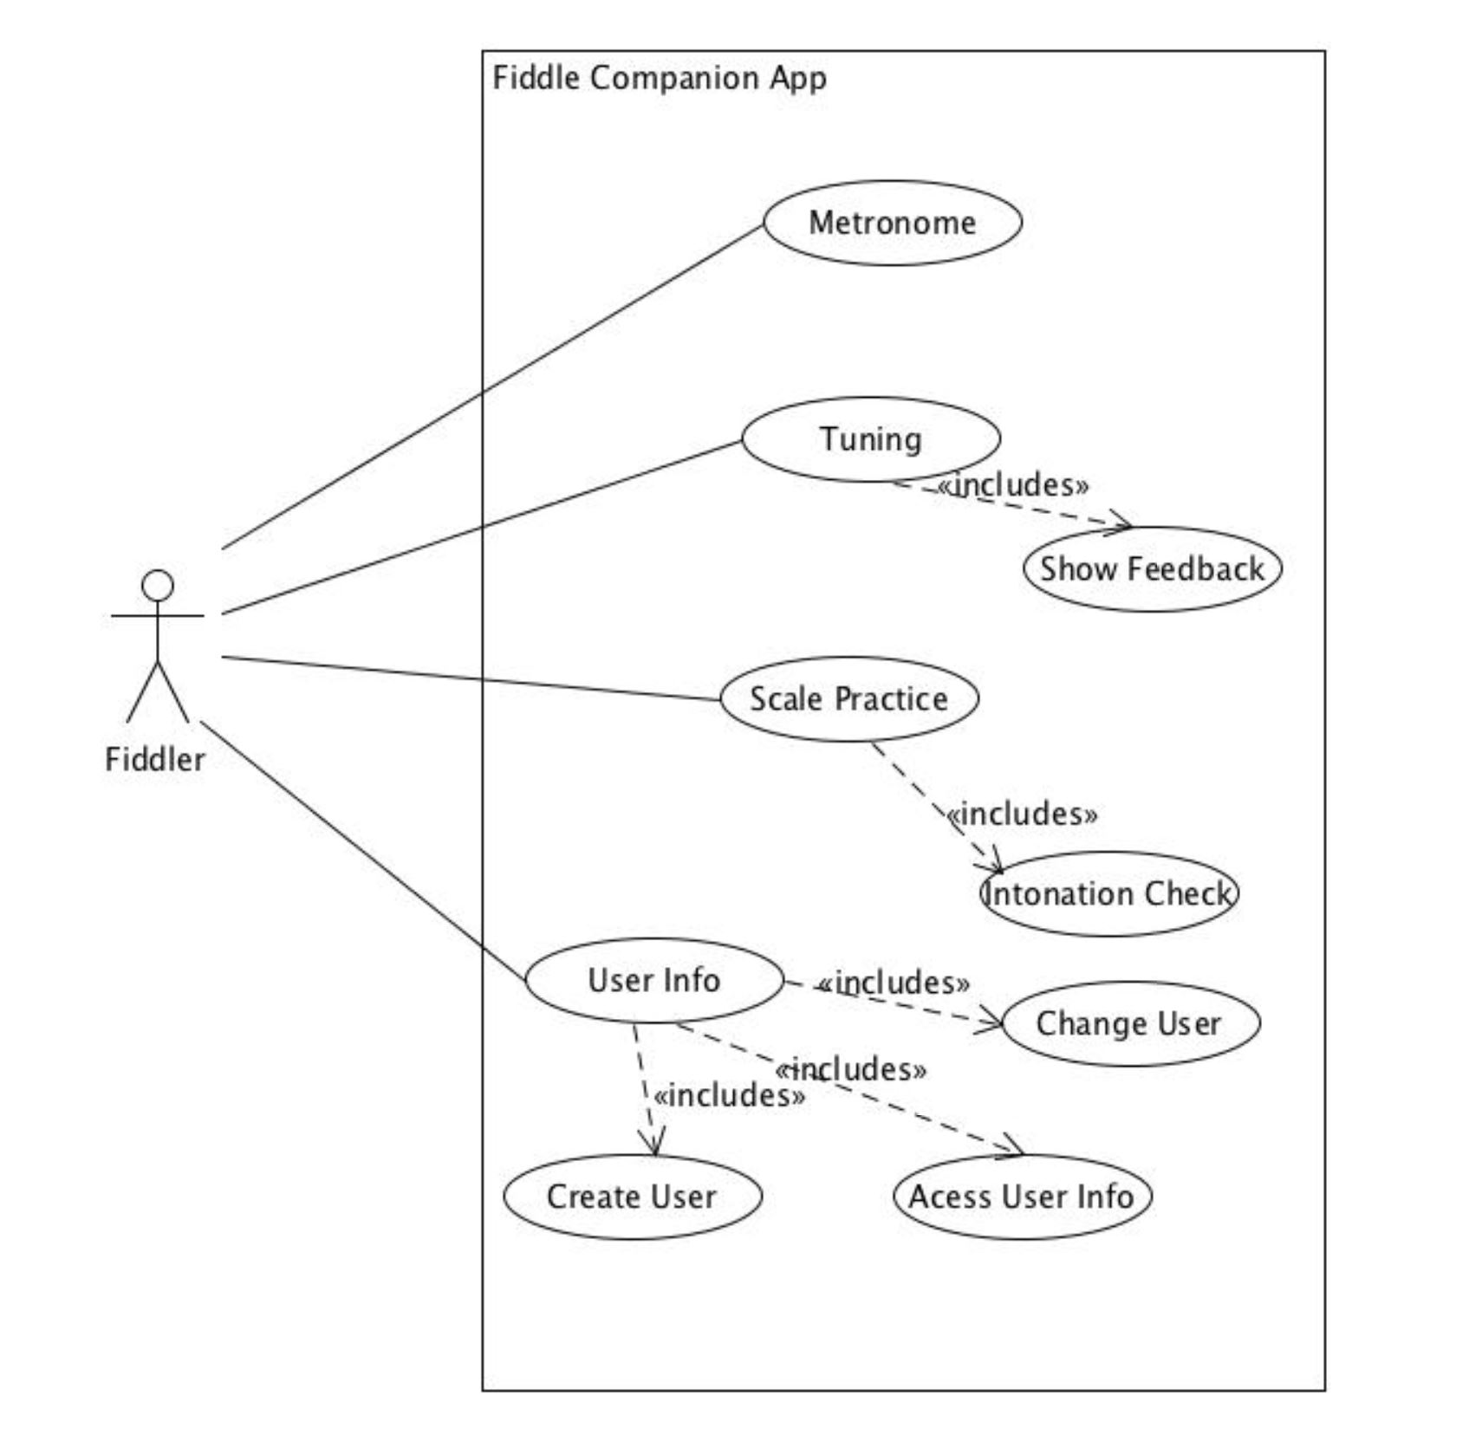
Use Case Diagram

Slide 14
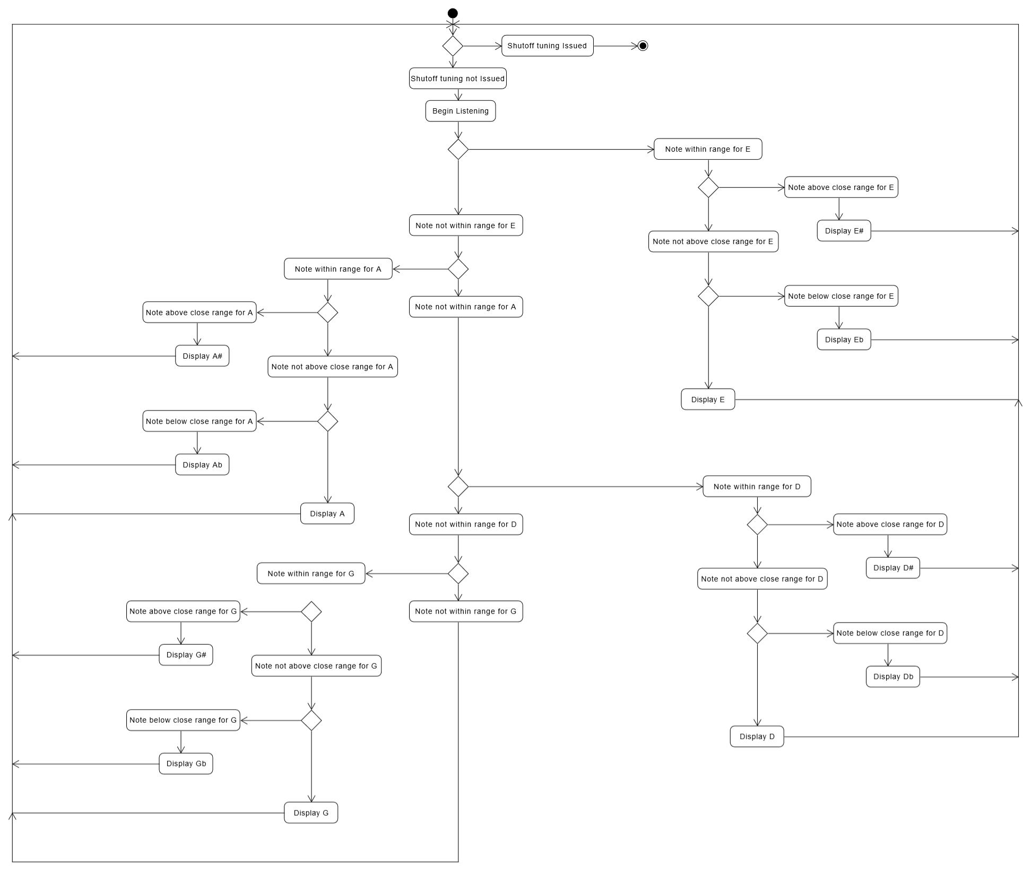
Tuning Assist
Activity Diagram

Slide 15
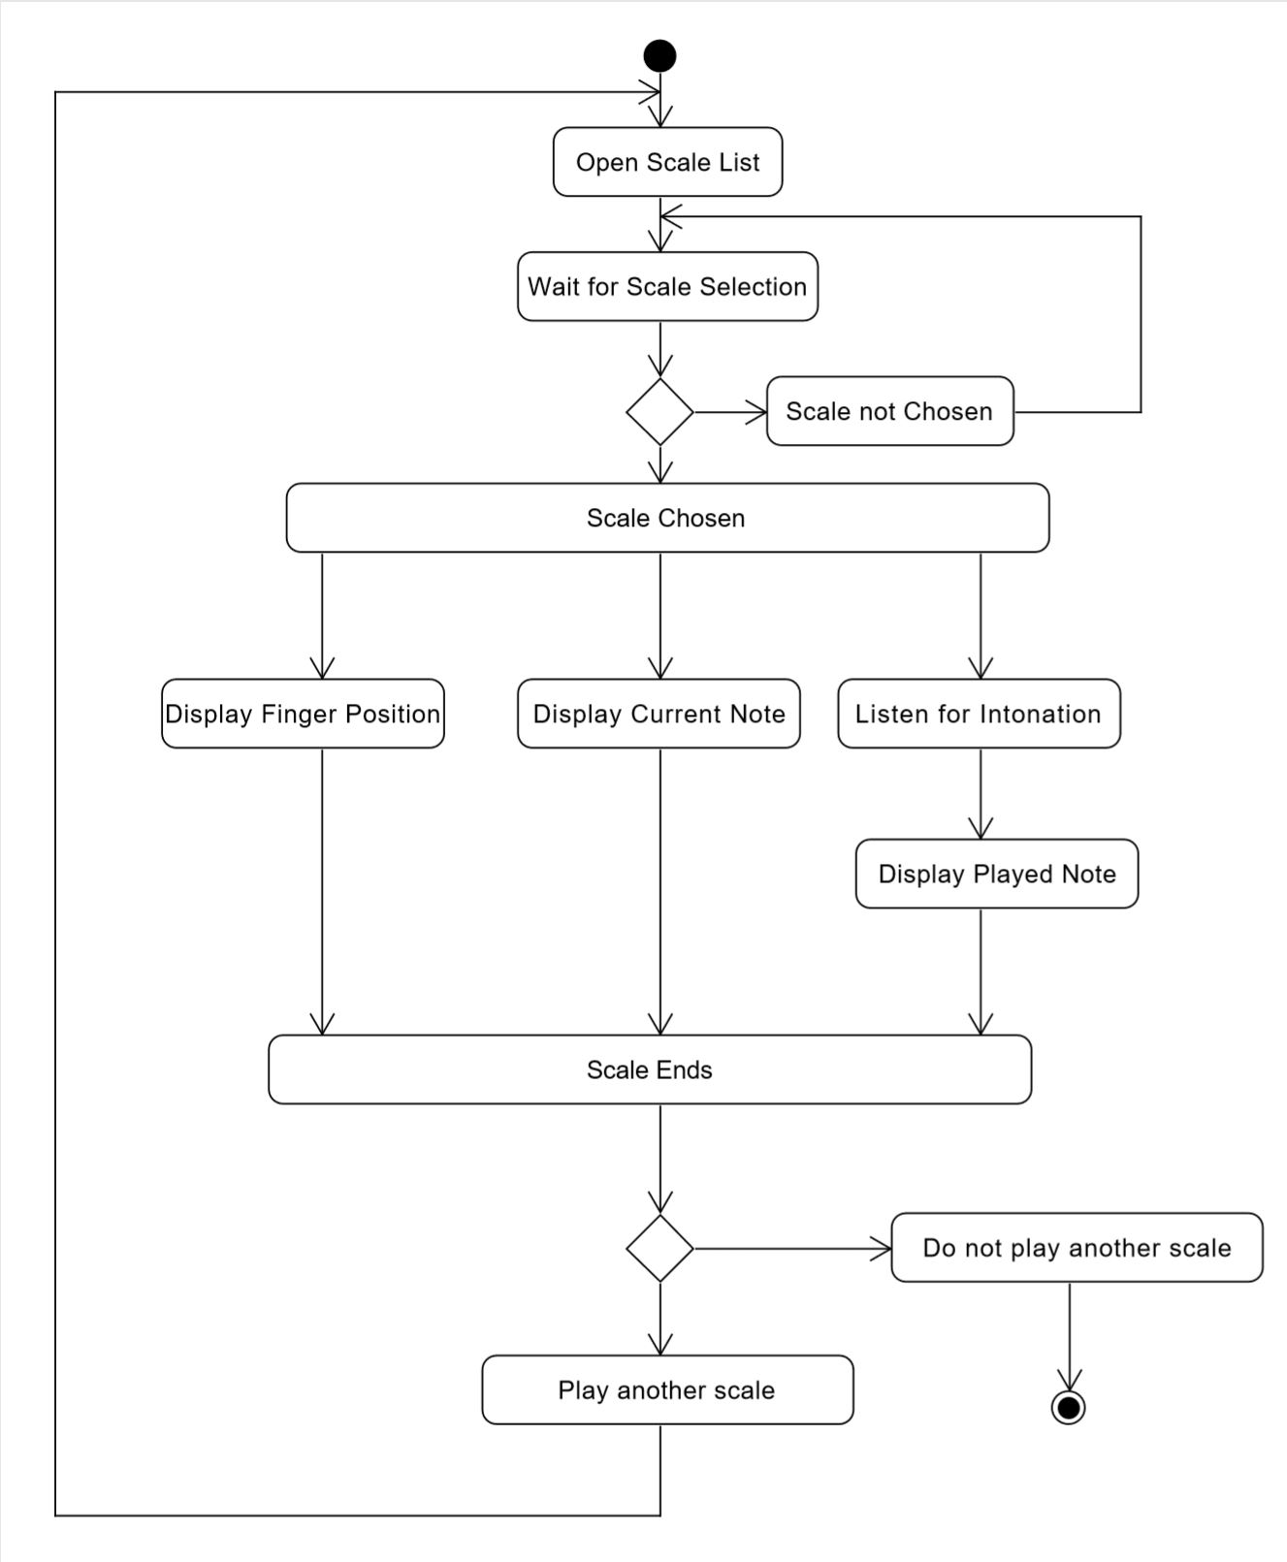
Scale Assist
Activity Diagram

Slide 16
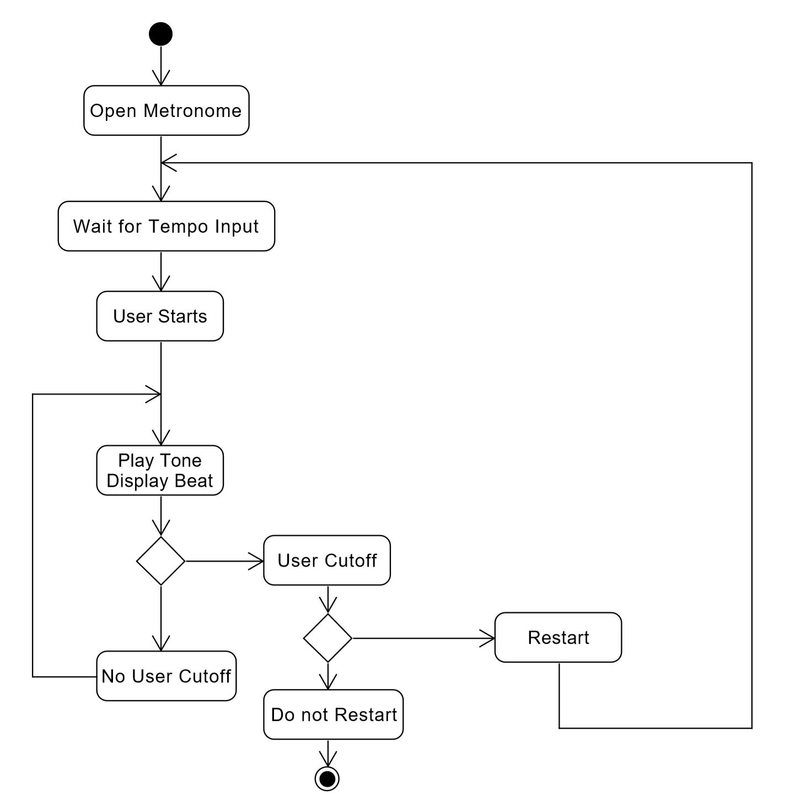
Metronome
Activity Diagram

Slide 17
What we will be working on for Sprint 2

